Slide 1

How the Canadian Government Works
Canada School of public service
Activate the blue button to start the course.

Slide 2
Modules
This course is divided in 5 modules :
Setting the Stage for Results
02
Setting the Agenda
04
Implementing the Agenda
01
03
05
Meeting the Players
Advancing the Agenda

Slide 3
How Things Work
The government makes decisions on what is in the public interest and acts on them.
One way to understand the system we work in is by examining the relationships involved in the delegation of responsibility.
Take Action
Responsibility implies an authority to take action.
Held to Account
Individuals with responsibility will be held to account by those who delegated the responsibility to them.
Judge
Those to whom we are accountable, judge how we carry out our responsibilities based on information about our actions.

Slide 4
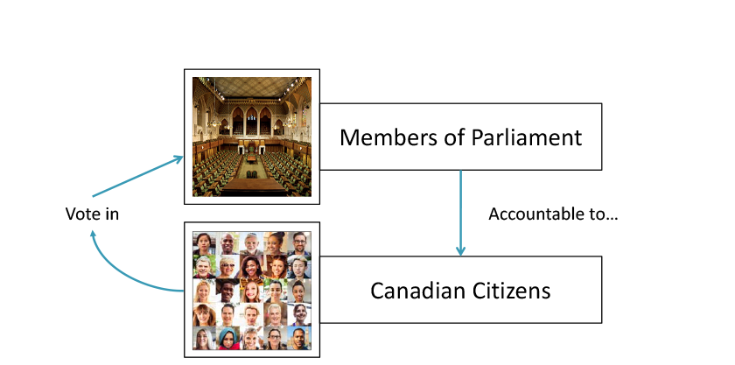
Members of Parliament
What this means is that there is a chain of delegated responsibility coupled with direct accountability.
Canadian citizens vote in Members of Parliament and give them the responsibility to represent citizens. This is done through a federal election.
Members of Parliament are accountable to the citizens.
To see the current list of Members of Parliament, activate this link: https://www.ourcommons.ca/members/en/search

Slide 5

Separating Power
An important feature of our system is the separation and independence of powers among three branches of government: -the Legislative Branch, -the Executive Branch, and -the Judicial Branch.

Slide 6
Central Agencies
Among departments, Central Agencies are unique in that they assist ministers in fulfilling their collective responsibilities. For example:
Department of Finances
PCO
TBS
The Department of Finance Canada helps allocate resources to allow ministers to implement their agendas collectively.
The Department of Finance Canada helps allocate resources to allow ministers to implement their agendas collectively.
The PCO helps coordinate implementation of the agenda and strives for coherence in Cabinet decisions.
The Privy Council Office helps coordinate implementation of the agenda and strives for coherence in Cabinet decisions.
The TBS supports Treasury Board by proposing and implementing management policies.
The Treasury Board of Canada Secretariat supports Treasury Board by proposing and implementing management policies.

Slide 7
Majority vs Minority government
Majority government
Minority government
In a majority government, the term (about four years) is more predictable because the governing party’s members of Parliament will usually vote to support their party staying in power.
In a minority government, there is uncertainty with respect to the length of the term, because opposition parties may collectively out-vote the governing party on matters of “confidence.”

Slide 8
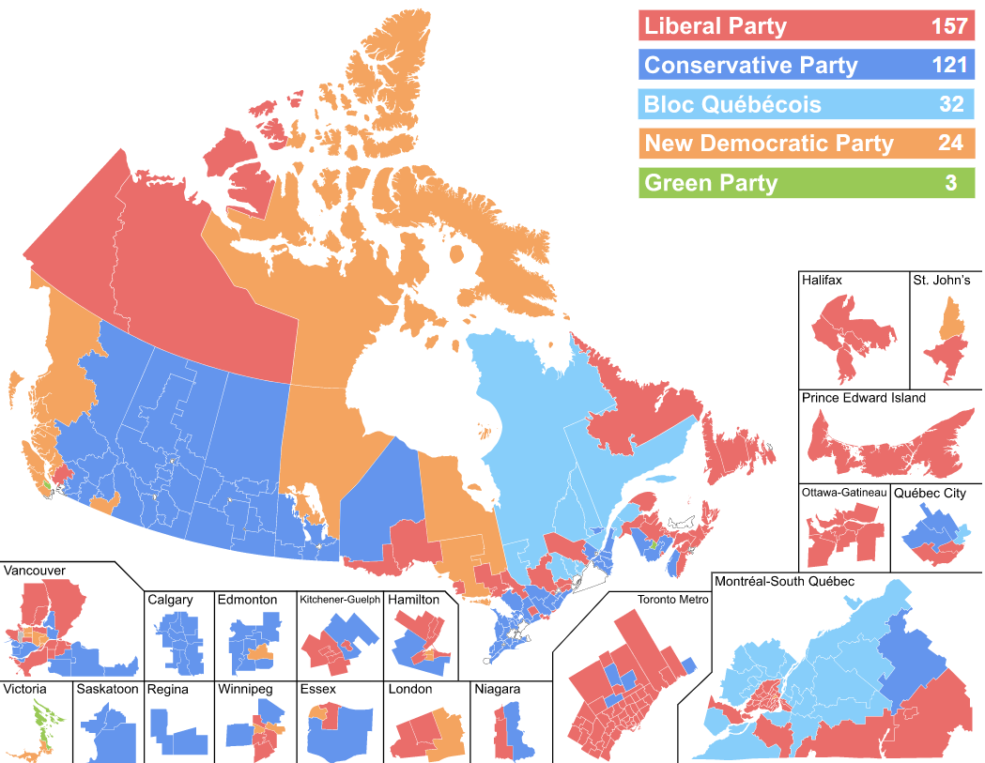
Map of the Canadian federal election 2019

